Slide 1
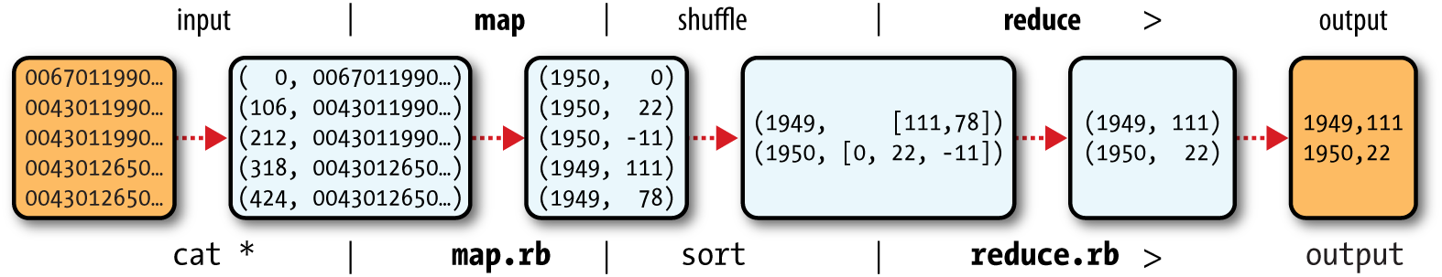
Analyzing the data with Hadoop - Map Reduce
Map Reduce Logical Data Flow

Slide 2
HDFS – Data Flow
File Read Operations
File Write Operations
Coherency Model

Slide 3
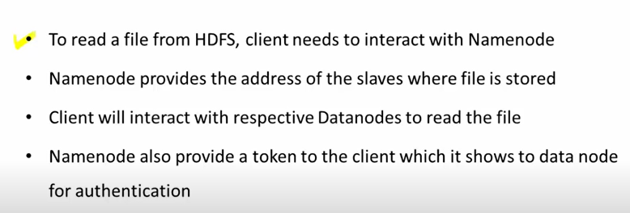
HDFS – Read Operations

Slide 4
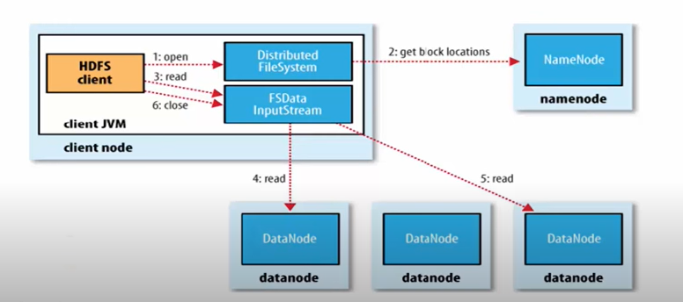
HDFS – Read Operations

Slide 5
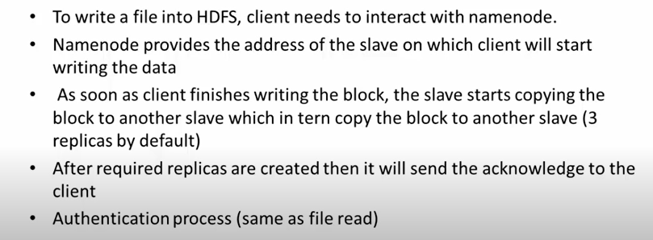
HDFS – Write Operations

Slide 6
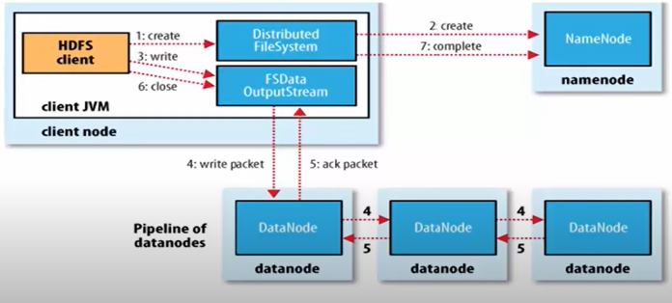
HDFS – Write Operations

Slide 7
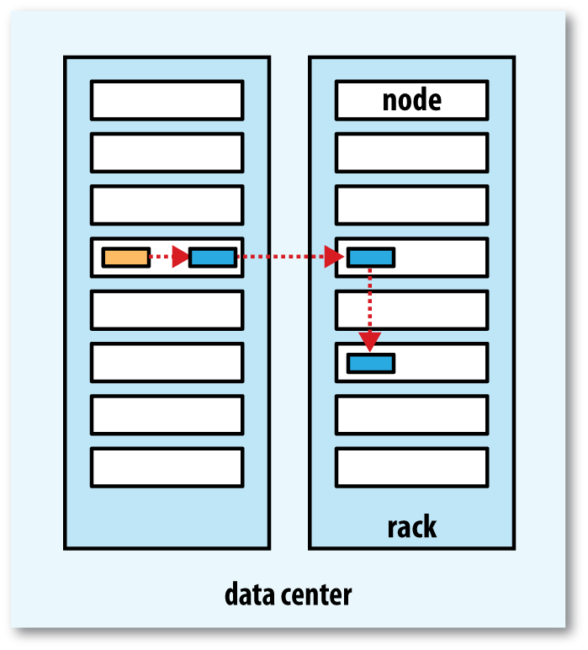
Replica Pipeline

Slide 8
Coherency Model
It is a Write-once-read-many access model for files.
This means that once a file is created, written, and closed, it Cannot Be Changed.
This will simplifies data coherency issues and enables high throughput data access.
The write-once-read-many coherency model is a Good Fit For Many Big Data Applications, such as batch processing and analytics.
However, it is not a good fit for applications that require append writes or real-time updates to files.
Parallel Copying with distcp
Keeping an HDFS cluster Balanced

Slide 9
HDFS - Interfaces
HTTP
  Direct Access
  HDFS Proxies
C Library – libhdfs
NFS
FUSE – Filesystem in Userspace

Slide 10
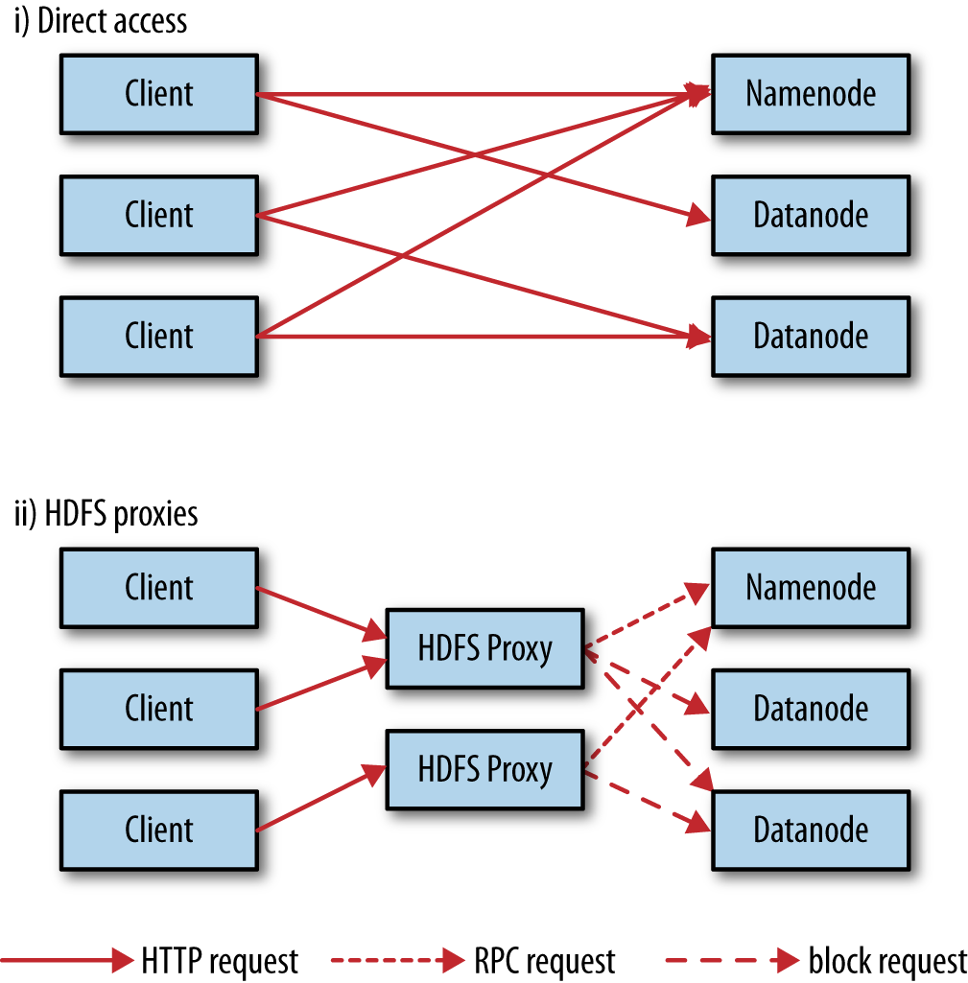
Accessing HDFS over HTTP directly and via a bank of HDFS proxies

Slide 11
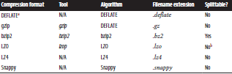
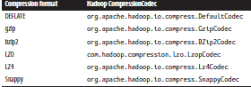
Hadoop I/O - Compression
Compression Formats
Compression Codecs

Slide 12
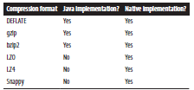

Compression Library Implementation
Compression Codecs Properties

Slide 13
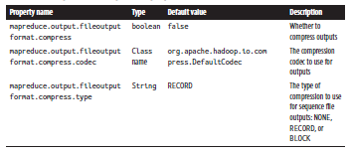

Map Reduce Compression Properties
Map Output Compression Properties

Slide 14
Hadoop I/O - Serialization
Writable classes in serialization are those that implement the Writable interface.
This interface defines two methods:
  write()
  readFields().
The write() method is used to Serialize The Object To A Dataoutput Stream,
& readFields() method is used to deserialize the object from a DataInput stream.
Writable classes are used in a variety of serialization frameworks

Slide 15
Writable Interface
Writable Classes
      Writable wrappers in java primitives
      Text
        Indexing
        Unicode
        Iteration
        Resorting to string
      Bytes Writable
      Null writable
      Object writable & generic writable
      Writable collections
Implementing a Custom Writable
Serialization Frameworks
  Serialization IDE

Slide 16
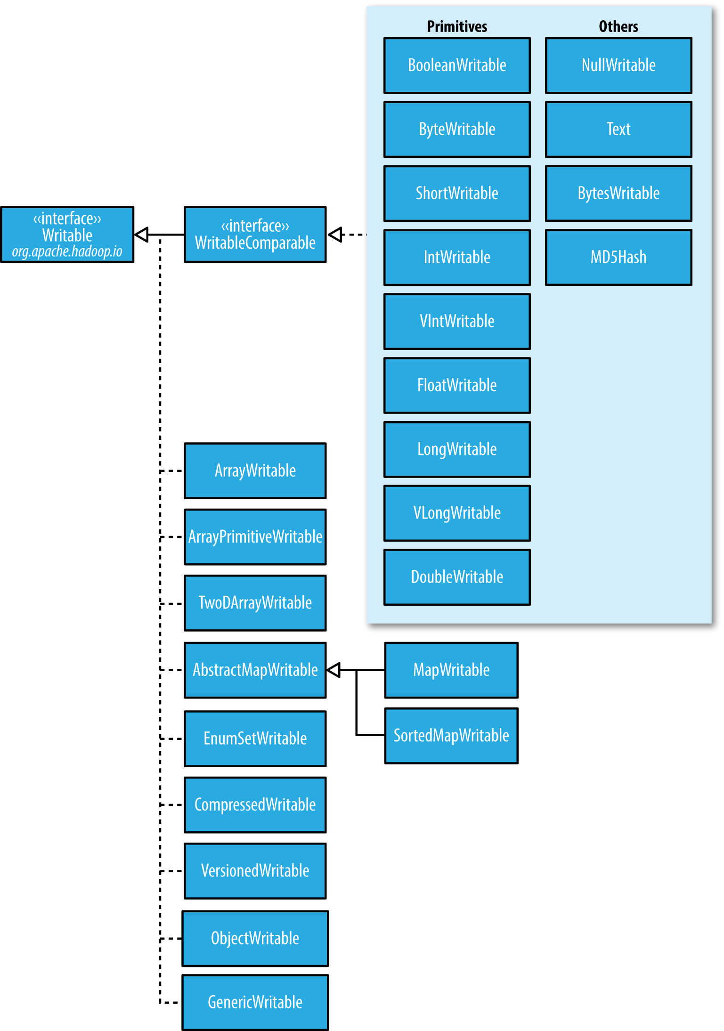
Writable Class Hierarchy

Slide 17
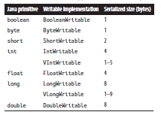
Writable Wrapper class for java primitives

